Slide 1

To-Do LIST
Developed by – Binayak Das
Roll no. – 20CS3023

Slide 2
Introduction
To-do lists are the lists that we generally use to maintain our day to day tasks or list of everything that we have to do, with the most important tasks at the top of the list, and the least important tasks at the bottom. It is helpful in planning our daily schedules. We can add more tasks any time and delete a task which is completed. This project is created by using HTML, CSS and JavaScript only.

Slide 3
HTML layout
Description of elements used in the code :-
Inside the body we have header with the h1 tag displaying the sentence To-Do List.
We have a form tag for taking the input from the user.
A div with the class select inside it we have a select tag with class filter-todo which basically filters the todos which shows all, completed, or uncompleted todos.
A div with class todo-container which will contain the users todos lists.
File name :- index.html

Slide 4
CSS Styling
Various CSS styles are used to make the webpage look more attractive.
Fonts styles are taken from google fonts (source - fonts.google.com).
Fall animation is added for the todos which are being deleted.
Animated text with ocean waves gif in the background (source – giphy.com).
Hovering and strikethrough effects are added.
For more details please refer :-
File name :- style.css

Slide 5
JavaScript part
Variables and event listeners are defined.
Function addTodo() is used for adding the todos/events to the list which are taken by the user in the form of inputs.
Inside the addTodo() we have defined the functionality of check mark button and delete button which helps us to check mark the completed todos or to delete them.
If add button is pressed without any content in the input, then an alert is generated.
And finally appending the complete todo div to the main div class.

Slide 6
Function deleteTodo() is used to implement the delete function in the web page.
filterTodo() function is created to filter the todos. This will separate the todos in all section, or completed section or uncompleted section depending upon the users choice.
And finally we have the savelocalTodos() to save the todos of the user in the local storage, so that when the webpage is reloaded or reopened, all the previous data should be saved in there and displayed in the browser.
File name :- script.js

Slide 7
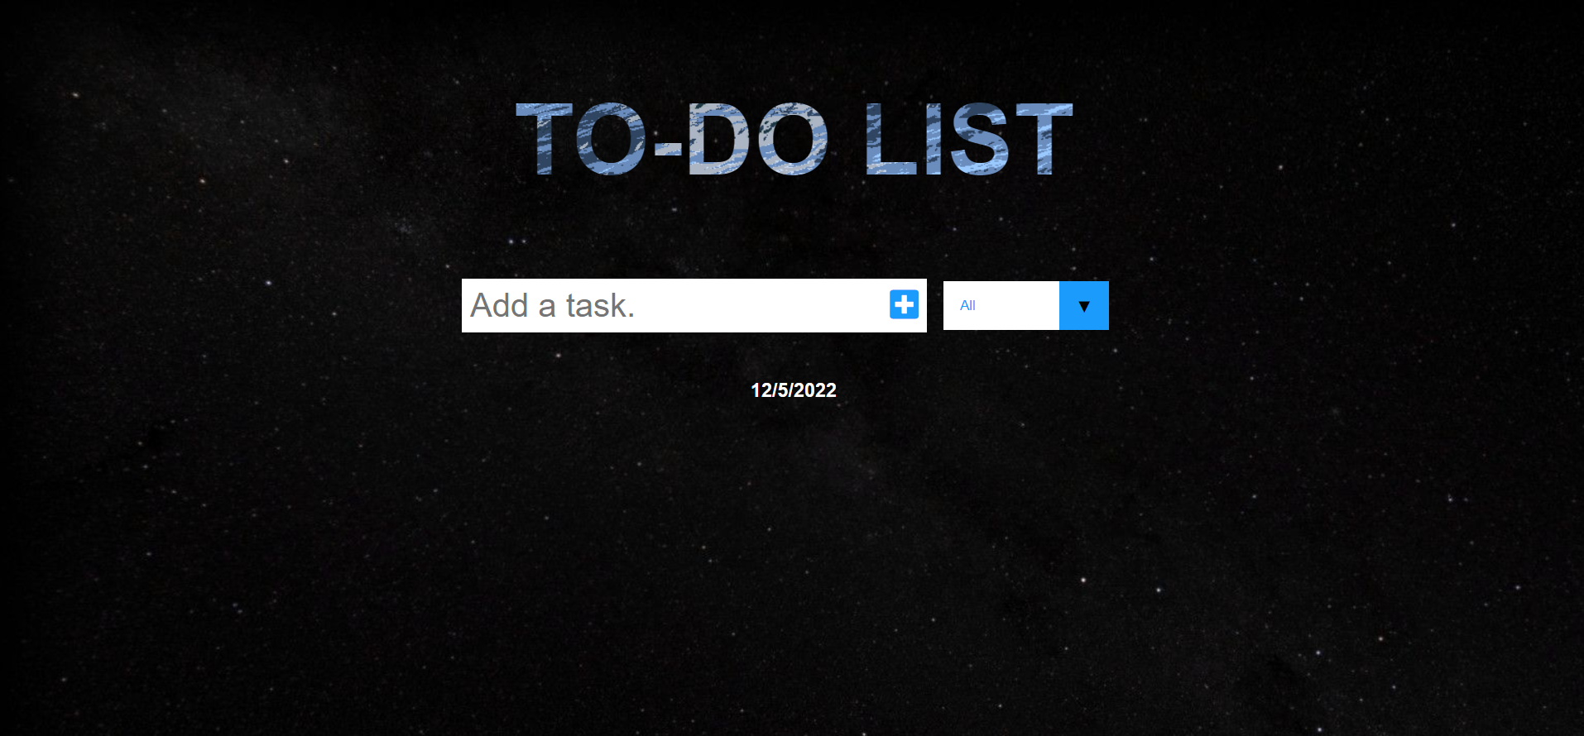

Slide 8
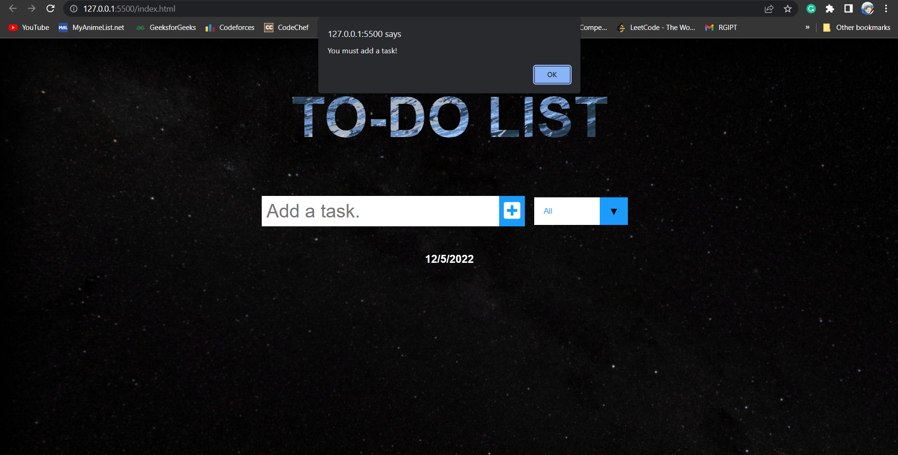

Slide 9
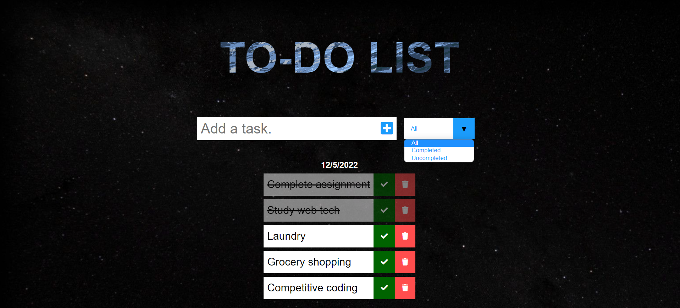

Slide 10
Rock-Paper-Scissors Game
Developed by :- Binayak Das
Roll no. – 20CS3023

Slide 11
Introduction
Rock, paper and scissors game is a simple fun game in which both the players have to make a rock, paper or scissors.
It has only two possible outcomes a draw, or a win, for one player and a loss for the other player.
The player has to choose one option among the rock, paper, and scissors. A random option will be generated form the computer’s side and the one who wins will get one point every time.
The game is completely responsive so that it can be played on every device.
Created using HTML, CSS and JavaScript.

Slide 12
The HTML layout
Description of elements used in code :-
A div with the class title is used to display the title on the screen.
A div with the class score-board contains two more div which will display the score of the player and computer.
A div with the class result which will display the result of the outcome of your move.
At last a div with class choices which contains three options rock, paper and scissors. The user can select any of the three options.
File name :– index.html

Slide 13
The CSS styling
Various CSS properties are used to make the game page look more attractive such as gradient background, catchy icons, glow effect around the border of the the users choice, hovering effects.
File name :- styles.css

Slide 14
JavaScript part
The main logic of the game is created by using JavaScript.
Defining variables such as userScore, computerScore, userScore_span, computerScore_span, scoreboard_div, result, rock_div, paper_div, scissors_div which are used throughout out JavaScript code to make the game interactive in nature.
Adding event listeners for click function in a created main() function.
Function getComputerChoice() is created for randomly generating the computer’s move. Either rock or paper or scissors.
Creating the game() function which will contain the basic logic of the entire game. Inside the function we are getting the userChoice and the computerChoice. Then defining switch case for various moves to determine the winner, looser or whether it’s a draw.

Slide 15
Win(), lose(), and draw() functions are used to define the outcome of the userChoice and computerChoice.
If according to our game function created in previous step, the user wins, in win() function we are incrementing the userScore.
If user loses then we are incrementing the computerScore in our lose() function.
And if it’s a draw then no increment takes place.
In all the three functions we are passing the arguments userChoice and computerChoice.
File name :- script.js

Slide 16
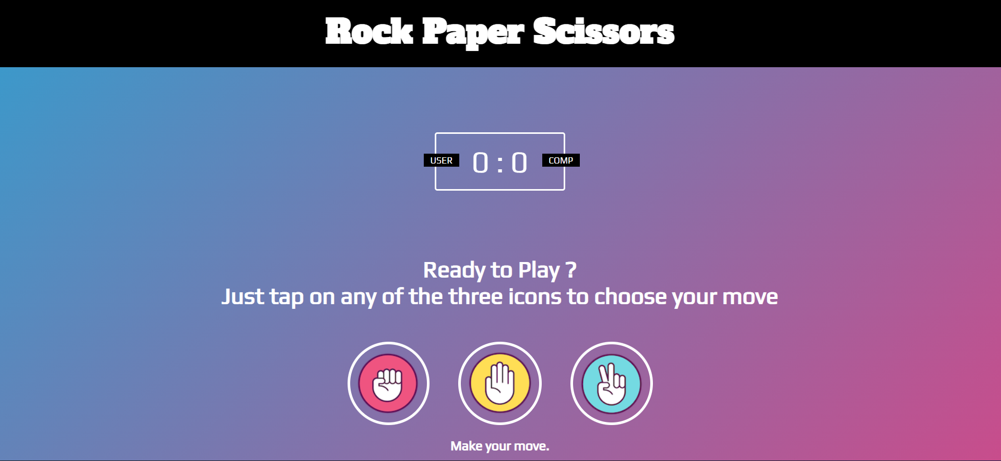

Slide 17
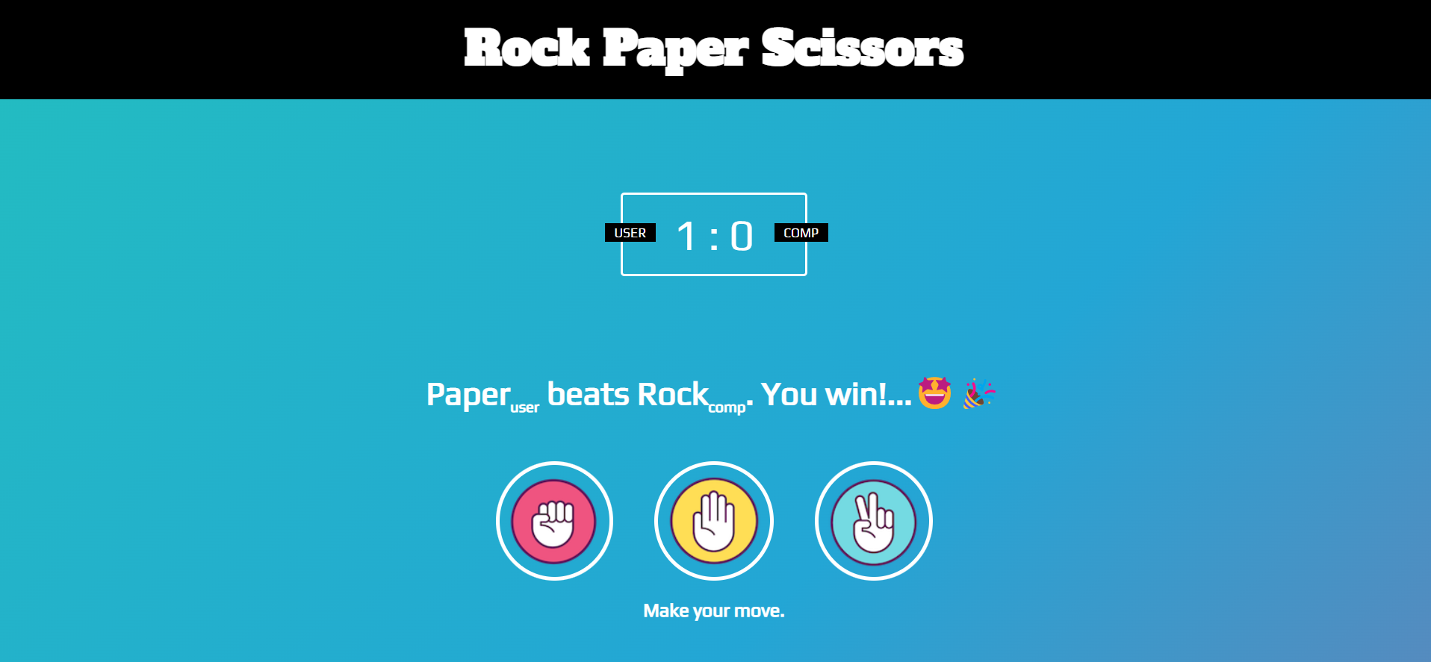

Slide 18
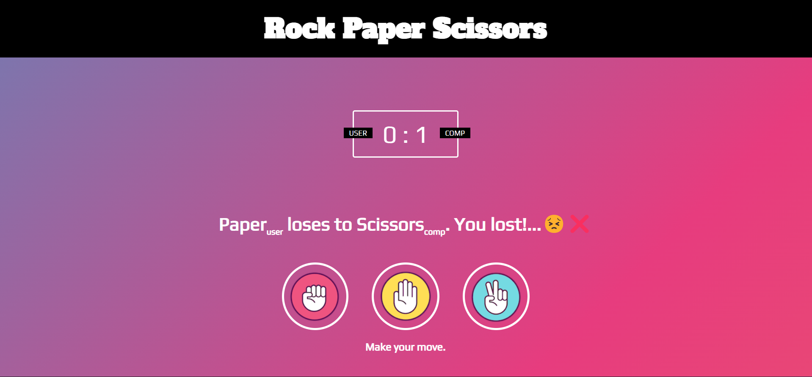

Slide 19
